Slide 1
DAT300 lecture/Chalmers 2018-09-19
Joris van Rooij
AMI System specialist @ Göteborg Energi
Industrial Ph.D. student @ Chalmers

Slide 2
Contents
Company information
Advanced Metering Infrastructure?
Example: AiMiR
Challenges

Slide 3
Every day – for a sustainable Göteborg!

Slide 4
Sustainable energy solutions

Slide 5
Goals
The city wants to:
Integrate and develop the utility in city development in order to reach a sustainable göteborg-community.
Have sustainable, reliable and affordable energy for the people in Göteborg.

Slide 6
Our mission
Production, distribution and trade in the energy area
Ensure affordable and reliable energy for the people in Göteborg
Be responsible for improving energy efficiency in Göteborg

Slide 7
Göteborg Energi numbers 2016
 | 2016 | 2017
Employees | 1 051 | 943
Result, mkr | 610 | 640
Turnover, mkr | 5 963 | 5 552
Electricity production, GWh | 735 | 339
Electricity distribution, GWh | 4 436 | 4 340
Sold district heating, GWh | 3 558 | 3 484
Sold gas, GWh | 940 | 910

Slide 8
We give back to our owners - ”göteborgarna”

Slide 9
Our fantastic District Heating
Provides warm water for 550 000 showers every day
Gives warmth to over 90% of the appartment buildings in Göteborg.
Has a reliability of 99,98%
Transported by 1 350 km pipes through the city
Mainly from waste heat
Is an example in Europe

Slide 10
Our stable Electricity supply
Runs 154 trams, 200 000 hairdryers och 95 000 streetlights
Distributed through 9 000 km of cables
Reliability of 99,99%

Slide 11
Every day… vi also work with
Gas
District cooling
Broadband
Biogas
Energy services
Charge infrastructure
City development
...and many new sustainable solutions for the future!

Slide 12
Göteborg is growing - 2035
150 000
more citizens
70 000–80 000
new houses
80 000
new jobs

Slide 13
Advanced Metering Infrastructure?
When is it advanced?
AMR Automatic Meter Reading
Log and send events
Send and receive control messages

Slide 14
New demands (2025)
Measure:
Production
Consumption
Active and Reactive
Voltage
Current
For every phase
Every 15 minutes
Realtime data to the customer
From 1 value per hour
To 13 per 15 minutes

Slide 15
AiMiR
ZigBee based AMI system
Aimir
server
GPRS
Fiber
ZigBee
MCU
Meter

Slide 16
AiMiR facts
270 000 electricity meters
5000 district heating meters
3000 water meters
8000 collector units
Self-healing radio network
Redundancy in metering values
Power quality data
Power outage events
Breaker function

Slide 17
Challenges
Time
278001 clocks in the network
How to deal with disagreements

Slide 18
Hypothetic time sync implementation
Central server
NTP
Collector units
Resets daily @ 8:00
Syncs twice a day against the central server (after reset and 12 hours later)
System clock with hardware clock as backup
Hardware clock syncs with system clock right after system clock sync
The hardware clock can lag many minutes per day
Meters
Receive a broadcast with the current time once every hour
And early during MCU bootup
What could possibly go wrong?

Slide 19
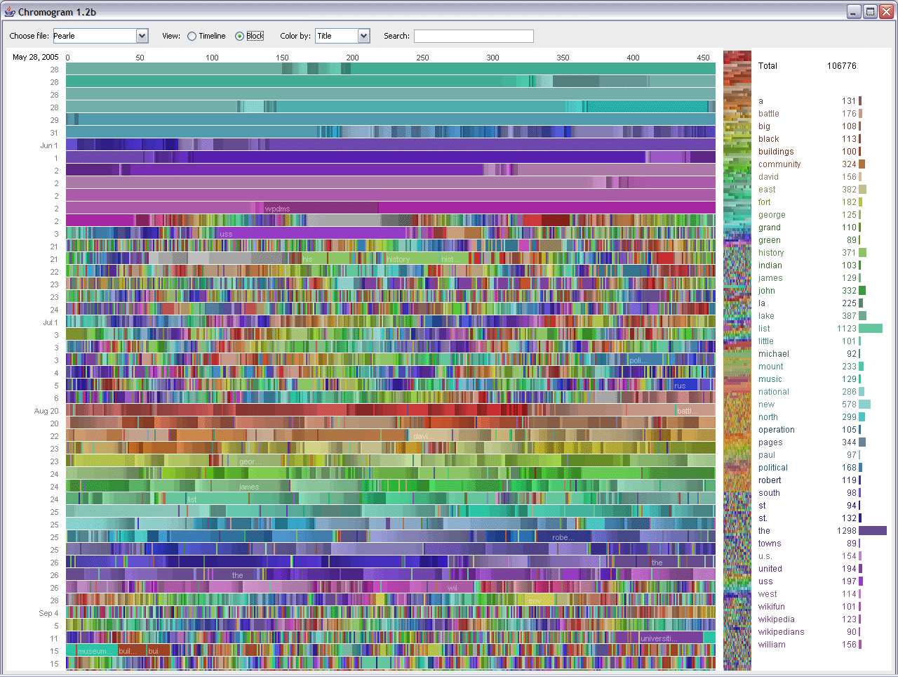
Challenges
Big data
270000 x 24 x 4 x 6 energy readings
270000 x 24 x 4 x 6 power quality values
Loads of events
Topology data
Noise
Every day…
Find the information in the data

Slide 20
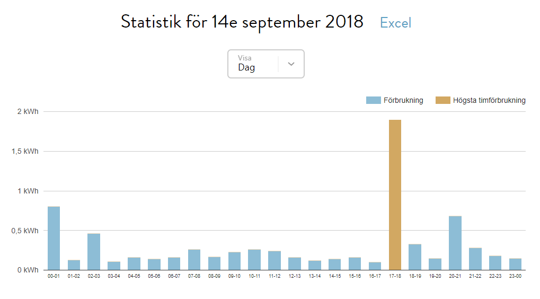
Challenge - Validation

Slide 21
Challenge - Validation

Slide 22
Challenge - Privacy
Higher resolution is coming

Slide 23
Challenge - Automation and control
Increasing demand – Unstable supply
(Automated) Demand response
Requires good estimate of network state
Predict missing values

Slide 24
Challenges
Emergence
Wikipedia:
emergence is the way complex systems and patterns arise out of a multiplicity of relatively simple interactions.
In other words:
Put lots of smart meters on a small area and unexpected things might happen.

Slide 25
Thesis opportunity!!
Many challenges – Many possibilities!
Contact me for more information

Slide 26
Questions?
Joris van Rooij
joris.vanrooij@goteborgenergi.se

